Slide 1









GROUP 9
ADVENTURE QUEST
An AI-Assisted Interactive Storytelling Game

Slide 2





Members
MAISHA RAHMAN
RUHAMA RAHMAN
MOHONA HAQUE
SHEIK MEHEDI

Slide 3













TODAY'S AGENDA
Introduction
Workflow
AI Decision Engine
Overview
Game Features
Challenges

Slide 4


INTRODUCTION
Artificial intelligence adds dynamic decision-making to games. This project uses a probabilistic AI model to suggest actions based on the player's energy and reputation. A factor graph helps the game adapt choices, making the story more immersive and responsive.

Slide 5

OVERVIEW
Interactive text-based adventure game
Built with Python, Tkinter, and pgmpy
Uses AI to guide player decisions
Enhances immersion with images, sound, and fading transitions

Slide 6




GAME
FEATURES
Dynamic story from JSON nodes
Player stats: name, energy, reputation, inventory
AI suggests best option at each choice
Save/load feature
Fade-in visuals + music per scene

Slide 7
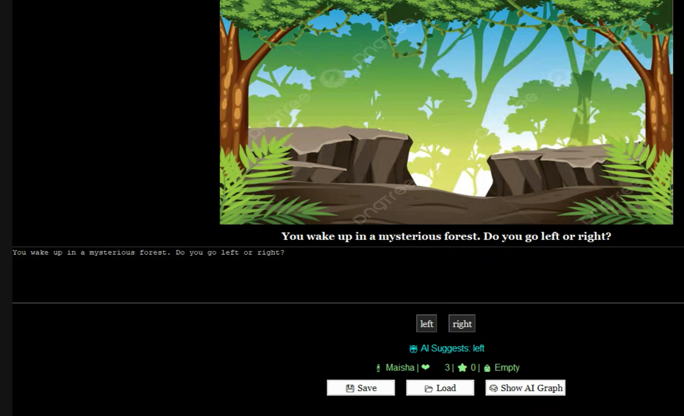
WORKFLOW
1. Startup
→ Enter name → Start from "start" node
2. Game Loop
→ Show narrative text
→ Display image + play music
→ AI suggests action
→ Player chooses → Effects applied
→ Move to next node

Slide 8
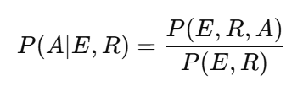
AI DECISION ENGINE
USES BELIEF PROPAGATION
Built using Factor Graph
Variables:
Energy (0–2)
Reputation (0–2)
Action ∈ {rest, sneak, fight}
Suggests action with highest probability

Slide 9

Challenges
Mapping AI decisions to narrative choices
Implementing smooth image transitions (PIL + Tkinter)
Robust save/load using pickle
No story loops yet; tree structure only

Slide 10

CONCLUSIONS
Factor Graph AI improves decision-making by giving smart, context-aware suggestions that shape the story. The game combines logic with creative storytelling in a flexible, scalable system that supports richer gameplay and adaptive narratives.

Slide 11


THANK YOU!

